Slide 1
Impacts on regional life expectancy
2004-2013
Shilpi Ray
Becky Li
Alexis Fox
Bryce Dudka

Slide 2
Motivation and summary:
Find a dataset we could actually use ☺
Understand and explain impacts to life expectancy in different regions of the world based on:
Income
How has income profile changed over time by region?
Is there an observable relationship between income and life expectancy
in aggregate? At the regional level?
Population
Has population grown/shrank/stayed the same?
Is there an observable relationship between population and life expectancy
in aggregate? At the regional level?
Fertility rates
How has fertility changed over time by region?
Is there an observable relationship between fertility rates and life expectancy
in aggregate? At the regional level?
Initial hypothesis: If income is increasing, life expectancy will increase
Additionally: of the variables we studied, income will have the highest correlation to life expectancy
Summary conclusion: Yes, increasing income leads to increased life expectancy in all regions, but it is not universally the most significant factor, fertility was.

Slide 3
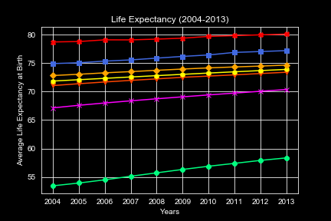
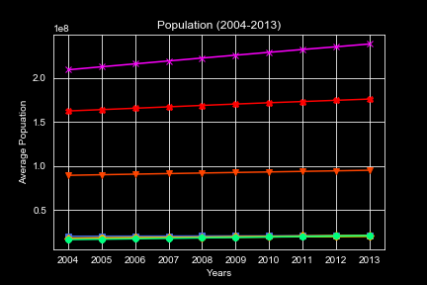
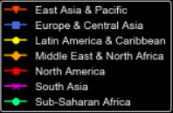
Summary data - analysis
Life expectancy has increased in all regions since 2004
Sub-Saharan Africa has experienced the steepest increase in life expectancy from 53.4 years to 58.3
In 2013, the most recent year studied, North America had the highest life expectancy at 80.1 years
Population has either increased or remained flat in all regions since 2004
South Asia has experienced the highest population growth form an avg of 205M per country to 238M per country
Only North America, South Asia, and East Asia & Pacific grew in population, all others stayed nearly constant.

Slide 4
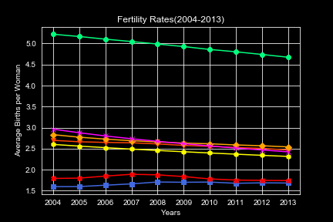
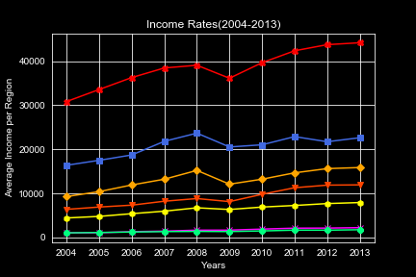
Summary data - analysis
Fertility rates (measured as avg births per woman) have decreased in all regions except Europe & Central Asia since 2004
Sub-Saharan Africa has experienced the steepest decline, but still maintains the highest fertility rates
Income has increased in all regions with North America showing the greatest gain (we probably don’t all agree ☺)
South Asia and Sub-Saharan Africa have had the smallest increase in income.

Slide 5
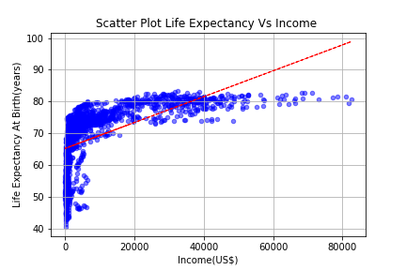
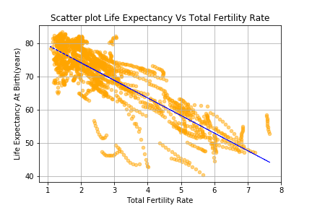
Correlations and trends
Income and life expectancy
Clear correlation between increase in income and increase in life expectancy for all regions; upward trend
non-linear correlation
R^2 = 0.595172
Fertility and life expectancy
Clear negative correlation between fertility rate and life expectancy for all geos – as fertility rates decrease, life expectancy increases
linear correlation
R^2 = -0.831430

Slide 6
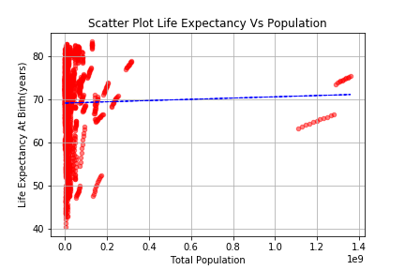
Correlations and trends
Population and life expectancy
No clear overall pattern of population, however each individual region shows strong correlation
R^2 = 0.021720
Next Steps:
Fertility rates clearly have the highest significance in explaining changed in life expectancy.
But because of strong trends in both fertility and income, we analyzed each region separately to investigate differences and find which factor had a higher correlation to life expectancy in each.

Slide 7
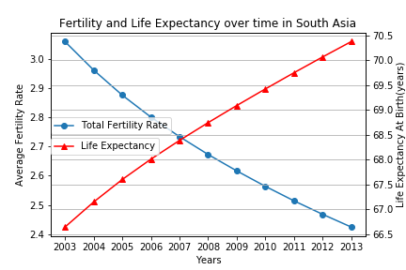
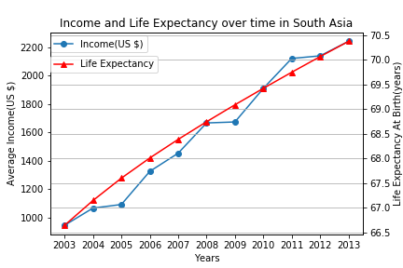
Regional study: South Asia fertility vs. income
R^2 = -0.998
R^2 = 0.990
While both are highly correlated – fertility has higher R^2

Slide 8
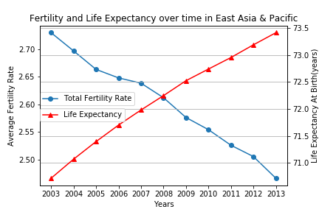
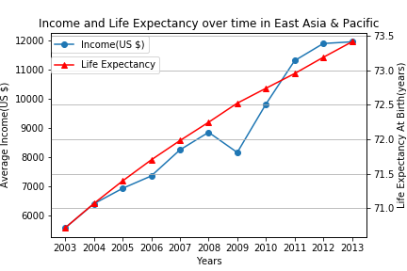
East Asia & Pacific fertility vs. income
R^2 = -0.987
R^2 = 0.956
While both are highly correlated – fertility has higher R^2

Slide 9
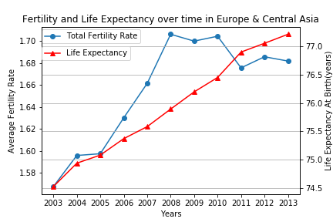
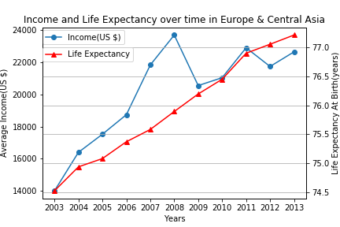
Europe and Central Asia fertility vs. income
R^2 = -0.742
R^2 = 0.750
While both are highly correlated – income has higher R^2

Slide 10
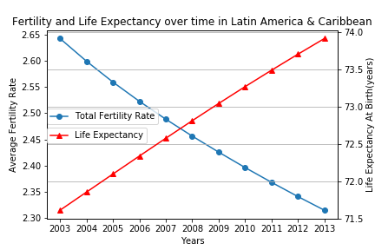
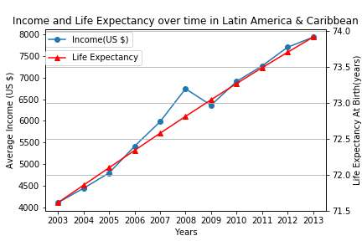
Latin America and Caribbean fertility vs. income
R^2 = -0.999
R^2 = 0.981
While both are highly correlated – fertility has higher R^2

Slide 11
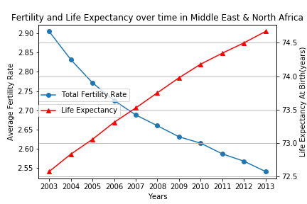
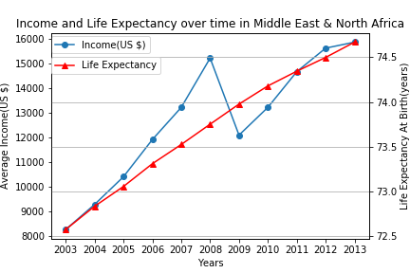
Middle East & North Africa fertility vs. income
R^2 = -0.991
R^2 = 0.878
While both are highly correlated – fertility has higher R^2

Slide 12
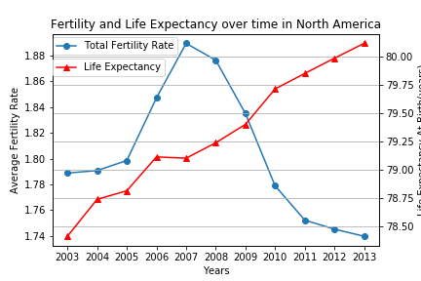
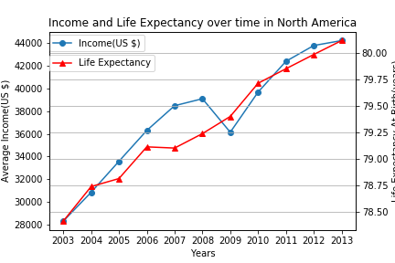
North America fertility vs. income
R^2 = -0.628
R^2 = 0.932
While both are highly correlated – income has higher R^2

Slide 13
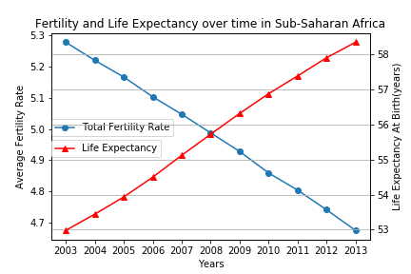
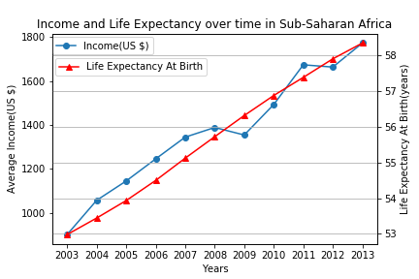
Sub-Saharan Africa fertility vs. income
R^2 = -0.998
R^2 = 0.977
While both are highly correlated – fertility has higher R^2

Slide 14
Conclusion
In all regions, income was significant in explaining increase in life expectancy
However, it was NOT universally the most impactful variable
In seven regions studied:
five showed fertility rate to be the most significant factor in explaining increased life expectancy
Sub-Saharan Africa
Middle East & North Africa
Latin America & Caribbean
South Asia
East Asia & Pacific
only two showed income to be the most significant
North America
Europe and Central Asia
To increase your life expectancy in North America, become rich and don’t have children!!!

Slide 15
Data process
Looked for like an entire afternoon for something fun to analyze ☺
Found data on Population; Fertility rates; Life expectancy data by country from 1960-2013 https://data.world/bhavnachawla/population-fertility-rate-life-expectancy/workspace/file?filename=Country-Population.xls
found data on average income by country 1960-2017: https://data.worldbank.org/indicator/NY.ADJ.NNTY.PC.CD
Combined four separate datasets into one master data set using “country”
Used groupby to combine 216 countries into 7 regions
Pulled out data for last ten years only (for manageability)
Created dataframes for each subcategory (life expectancy; population; fertility; income)
Used dataframes as basis for all subsequent analysis and graph production

Slide 16
Issues along the way
Missing data, lot of zero values
Some data set had different named columns, extra columns
Not all data had all countries
Different years for each – all started in 1960 but ended in 2016, 2017, 2013, etc.
Non-linear data – (had to convert x-axis into log to gain insights on correlation)
Directions we could go with more time
Add in more data sets by country – age, ethnicity, gender, education, family size etc.
Perform same analysis back to 1960
Perform analysis for key countries of interest
Create prediction model

Slide 17
Q&A
Example questions:
What is your favorite color?
Where are you from originally?

